Slide 1
Learning Salient Objects in a Scene using Superpixel-augmented Convolutional Neural Network
Notes:
Hello everyone. I am Yash Patel and this is my teammate Shashank Tripathi. We’ve worked on saliency detection in natural scene images using super-pixels.

Slide 2
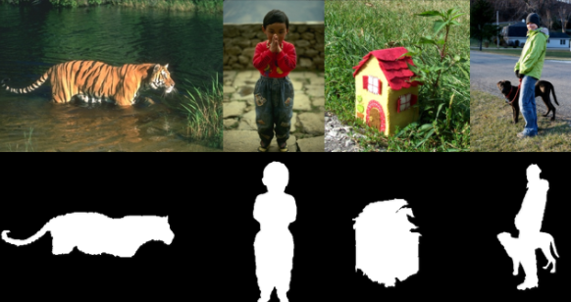
Problem Overview
Given a natural scene image, objective is to detect “salient” regions.
Notes:
Salient regions in an image are defined as the regions that attracts attention of human observer. These regions are loosely defined as the regions which “pop-out” in an image. The general idea is to mark each pixel as foreground or background.
Saliency detection is widely used for complex computer vision tasks such as object detection and semantic segmentation.

Slide 3
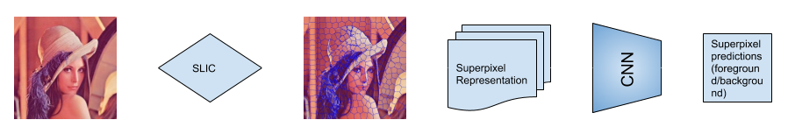
Method overview
Superpixels are generated using slic segmentation algorithm
Saliency detection specific Hand-crafted representations are obtained
Per superpixel binary classification is done using shallow CNN
Notes:
The adopted method can be broadly divided into 3 sub-parts:
1). Given a natural scene image, first the super-pixels are obtained using a popularly known method “SLIC”. Super-pixels are the group of nearby pixels with similar in terms of color and texture.
2). In order to capture the global spatial context of image and relation of super-pixel with every other super-pixel in the image, certain hand-crafted representations are obtained.
3). Finally, using a CNN trained on super-pixel representations, each super-pixel is classified as foreground or background.

Slide 4
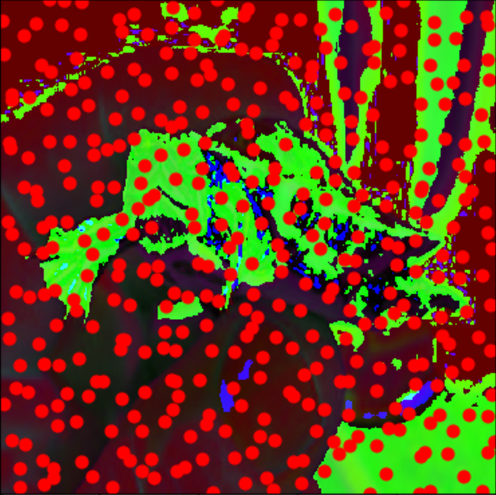
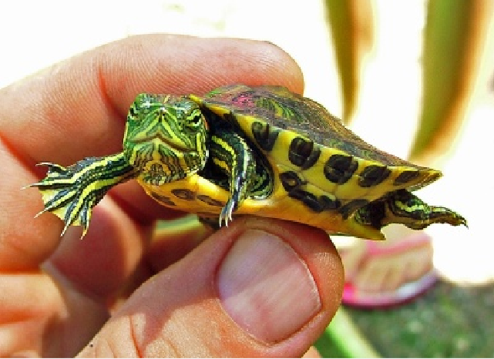
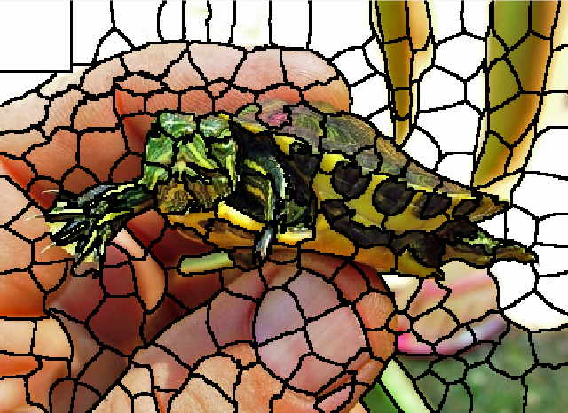
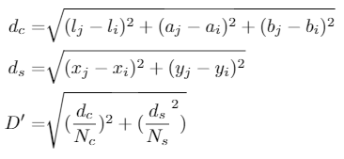
SLIC superpixel generation
Notes:
Convert the image to lab space. Lab space has been shown to capture a wider color gamut since it has a separate channel for contract -black and whites. We divide the input image into a grid, whose dimensions are decided by the number of superpixels required. In every gridsquare, we randomly initialize the superpixel centers, and run the simple k-means clustering on the whole image. A subtlety here is that the search space is limited to a neighbourhood around the superpixel center, instead of the whole image. This reduces the complexity to O(N) where N is the number of pixels, and is independent of the number of superpixels. We run this iteratively to generate the superpixel regions in the image.

Slide 5
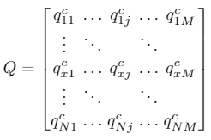
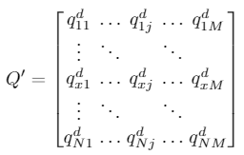
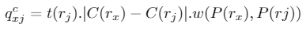

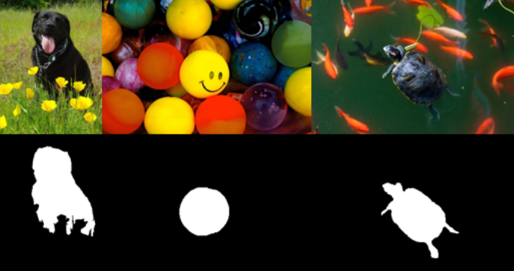
Superpixel representations
Notes:
We can’t use the superpixels directly because the superpixels are stochastic, determined by the superpixel mean initializations. We retain spatial information by defining superpixel representations.
To create superpixel representations, we define a color separation matrix Q which captures the color separation of each superpixel withall the other superpixels. Each row corresponds to one superpixel and each element in this row is the comparison score with every other superpixel. So this matrix has dimensions NxN. The color separation score is given by the difference between the separation in the mean color vector. A gaussian weight is applied on the color difference based on how far the superpixels are in image space. Using this vector only encompasses the color separation, and in the following images, the flowers, the other balls and the fishes will also be labeled as salient. To avoid this, we observe define a dual matrix Q’ which captures the property of salient regions to be locally connected in the image foreground.

Slide 6
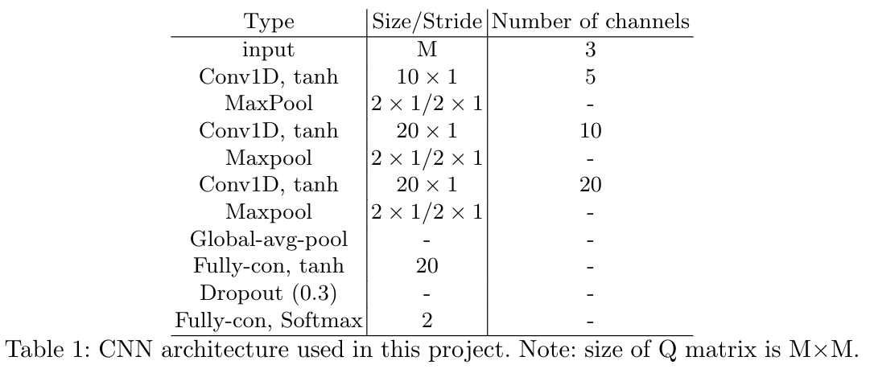
Classification using shallow CNN
Total number of parameters: 5,233
Total Number of parameters in conv layers of vgg-16: 14,714,688
Notes:
It is important to note that each row of the obtained Q-matrix captures the relation of a given super-pixel with all other super-pixels in the image. Once we have obtained these representations for the super-pixels, we make use of CNN for per super-pixel classification.
We extensively experimented with varying number of filters, filter-sizes and number of layers, and empirically concluded with the “this” architecture. Further, each image will have varying number of super-pixels, to incorporate this in varying sized input we use Global-Average-Pooling after the last convolutional layer.
Observe the number of parameters in this CNN architecture compared to parameters in Conv. layers of VGG-16.

Slide 7
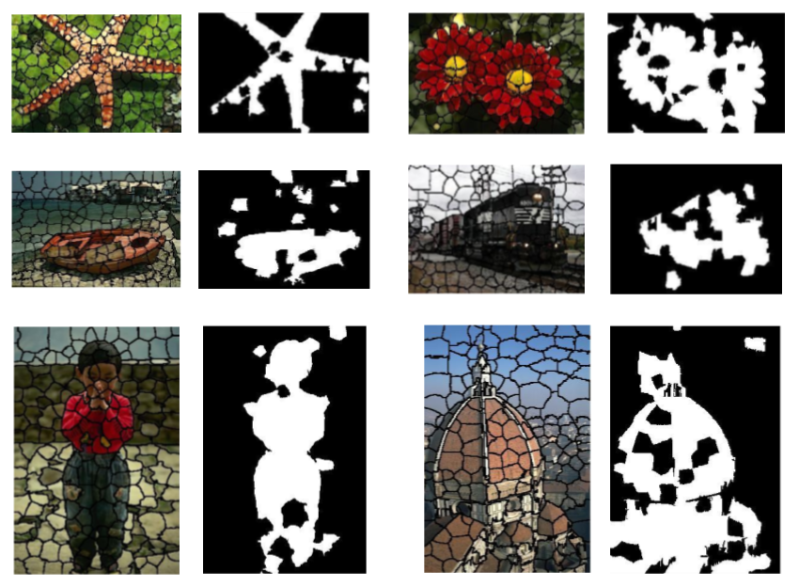
Results
Notes:
These are some of the qualitative results. In the first image, the starfish is the salient object. Similarly the flowers are the salient object in 2nd images. As we can see that the method is able to reasonably obtain the salient regions.

Slide 8
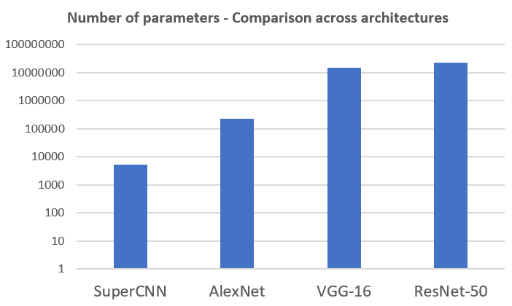
Conclusions
Hand-crafted features capturing global spatial context at superpixel level along with CNN classifier shows decent performance for saliency detection in images.
Superpixel-CNN based approach does not require large training data and number of parameters in CNN are in few thousands compared to 10s of millions of parameters in standard CNNs on raw image pixels.
Lower number of parameters reduces the computational cost significantly at both training and test time.
Notes:
In conclusion, we would like to say that:
1). Using cleverly obtained hand-crafted features along with CNN for classification can give reasonable results for saliency detection in natural scene images.
2). The use of super-pixels dramatically brings down the number of parameters and computation cost.
3). Understanding “salient” regions is challenging is could be subject specific, for eg: your crush is in-front of you then he/she will be the most salient entity and probably global spatial context and textures will not really matter.

Slide 9
thanks!
Shashank Tripathi
Yash Patel
shashanktripathi123@github
yash0307@github
Code is available here: https://github.com/yash0307/SuperCNN

